Slide 1
Circuit Mapping with GIS

Slide 2
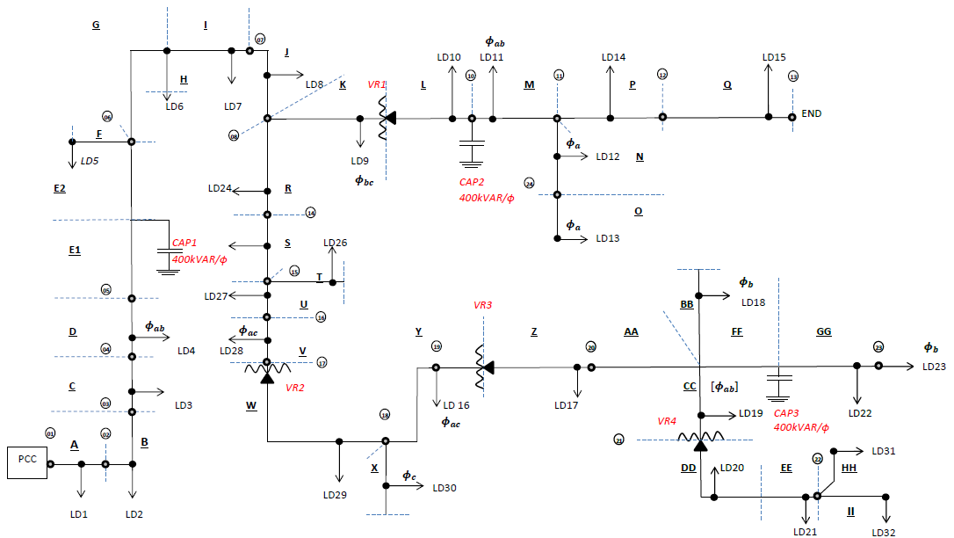
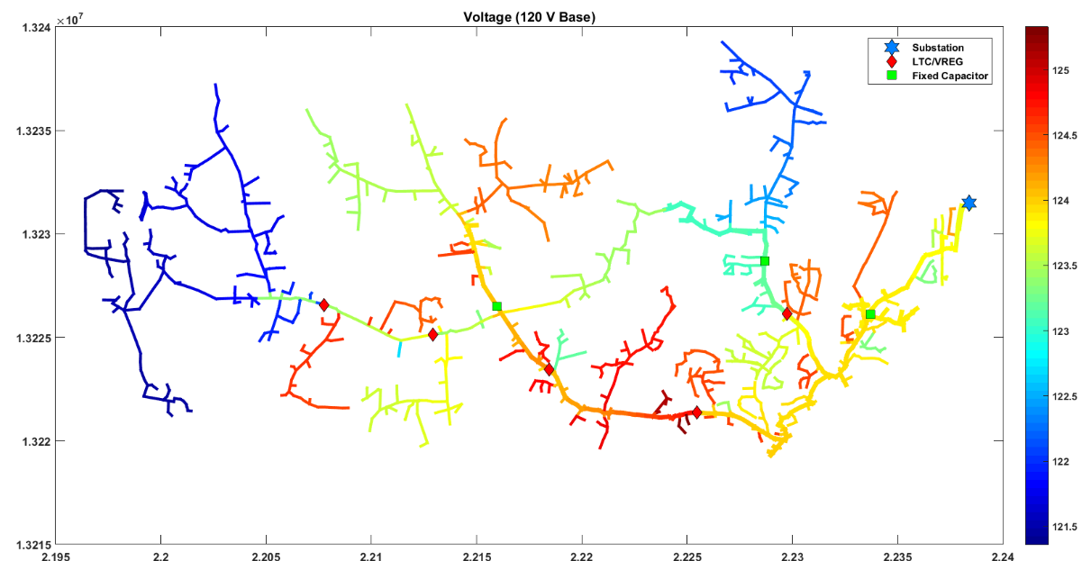
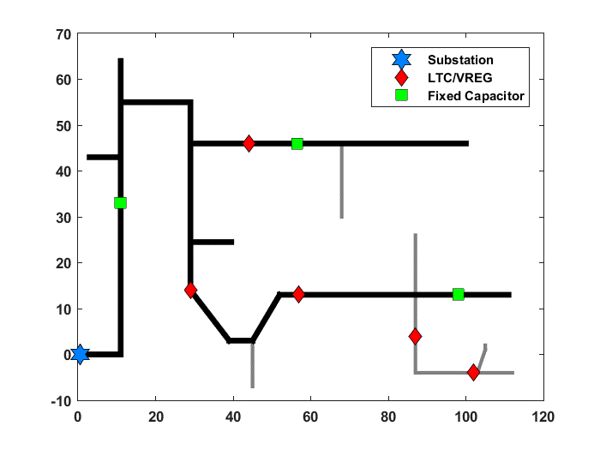
Feeder Reduction Recap

Slide 3
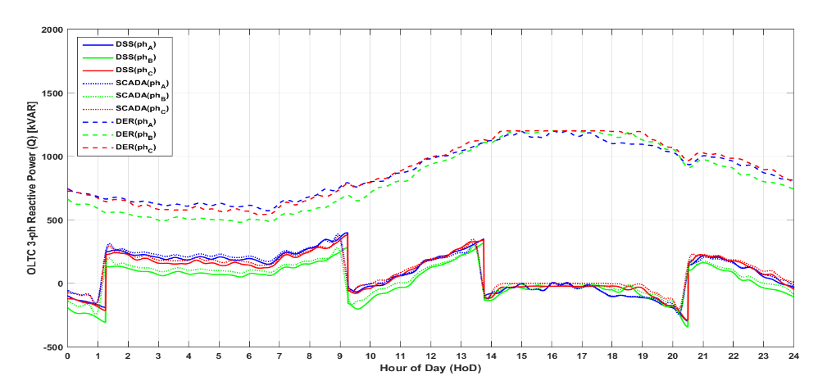
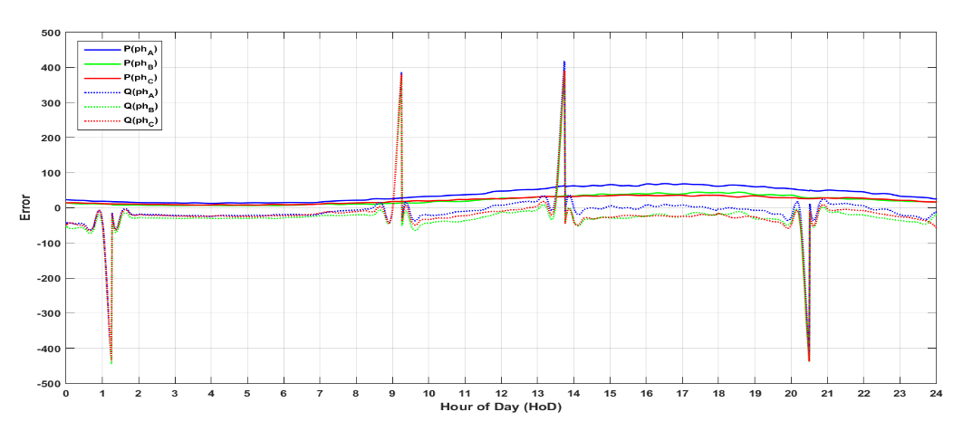
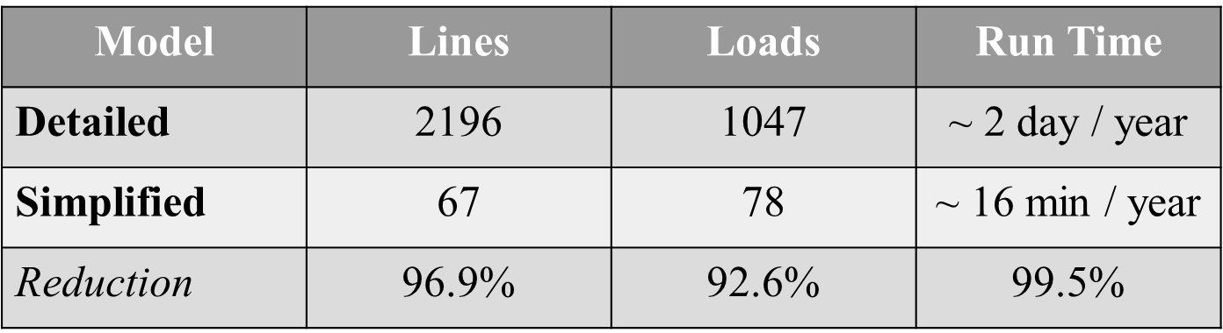
Feeder Reduction Recap

Slide 4
Program Flow
CYME
Shape File
OpenDSS
Coordinates
Determine DG Location on Feeder
Suitable Location
ID
Bus1
Bus2
Lat
Long
Update
Analysis

Slide 5
Program Flow
CYME
Shape File
OpenDSS
Coordinates
Determine DG Location on Feeder
Suitable Location
ID
Bus1
Bus2
Lat
Long
Update
Analysis

Slide 6
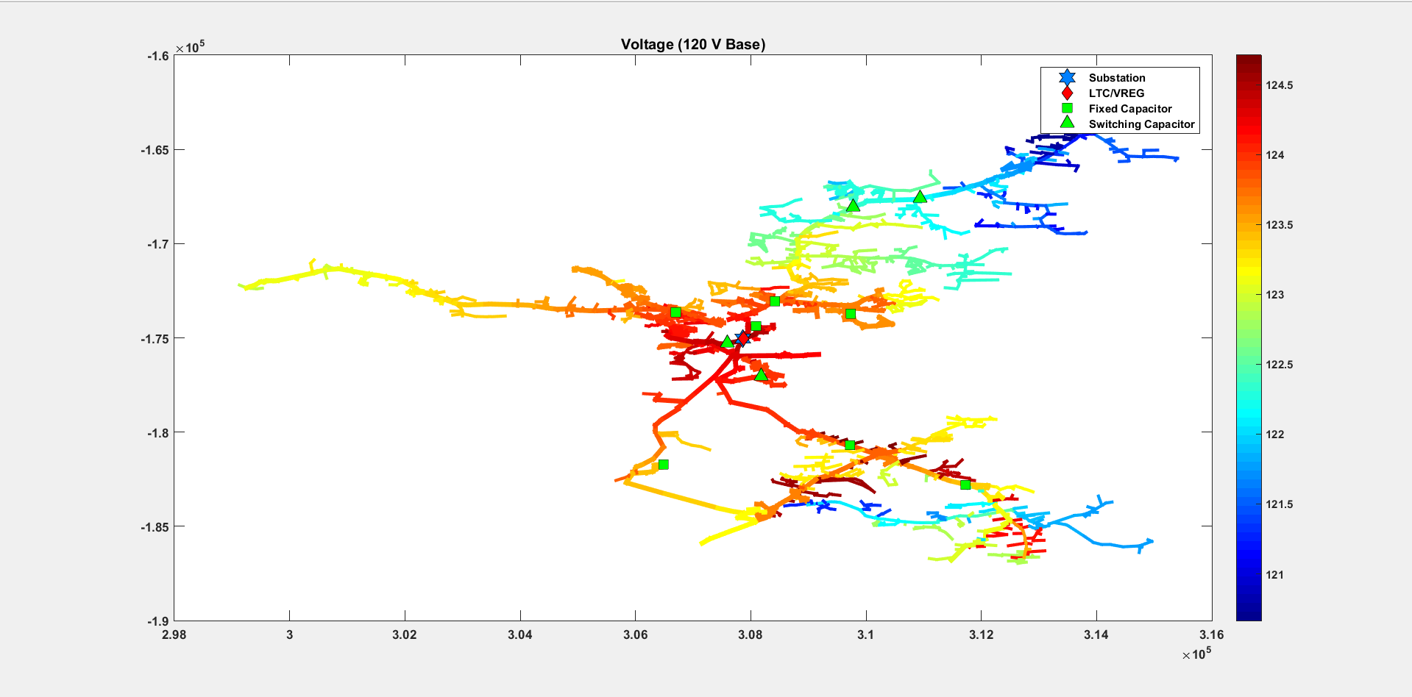
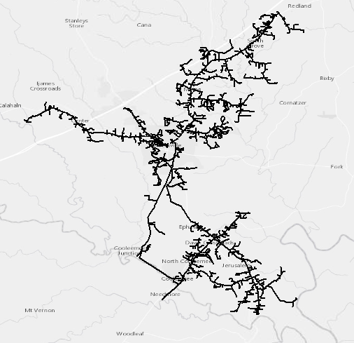
Example Feeder Plotted in ArcGIS

Slide 7
Program Flow
CYME
Shape File
OpenDSS
Coordinates
Determine DG Location on Feeder
Suitable Location
ID
Bus1
Bus2
Lat
Long
Update
Analysis

Slide 8
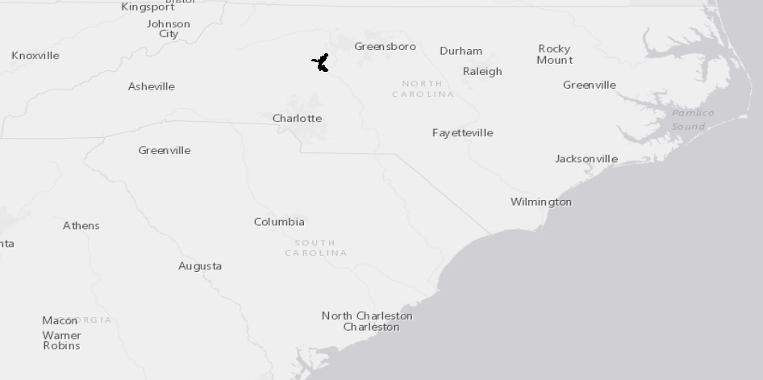
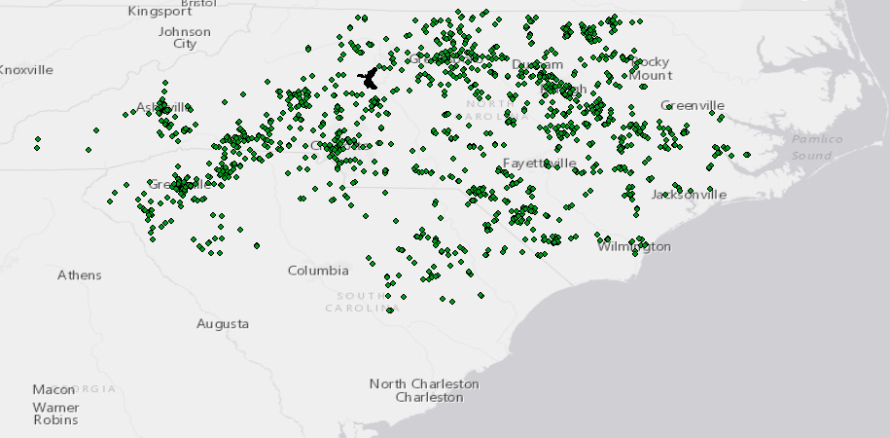
Determine DG Location on Feeder

Slide 9
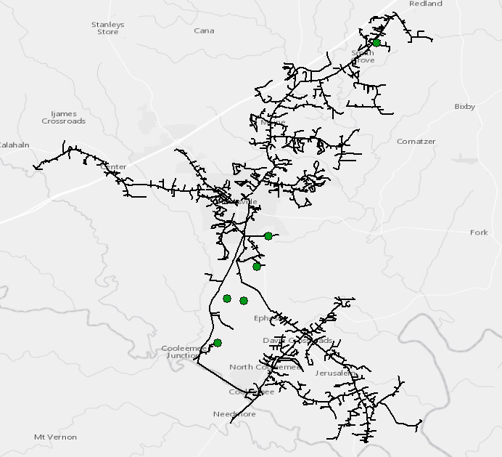
Determine DG Location on Feeder

Slide 10
Program Flow
CYME
Shape File
OpenDSS
Coordinates
Determine DG Location on Feeder
Suitable Location
ID
Bus1
Bus2
Lat
Long
Update
Analysis

